Slide 1
Literary Elements
Review of What you Learned Last Year

Slide 2
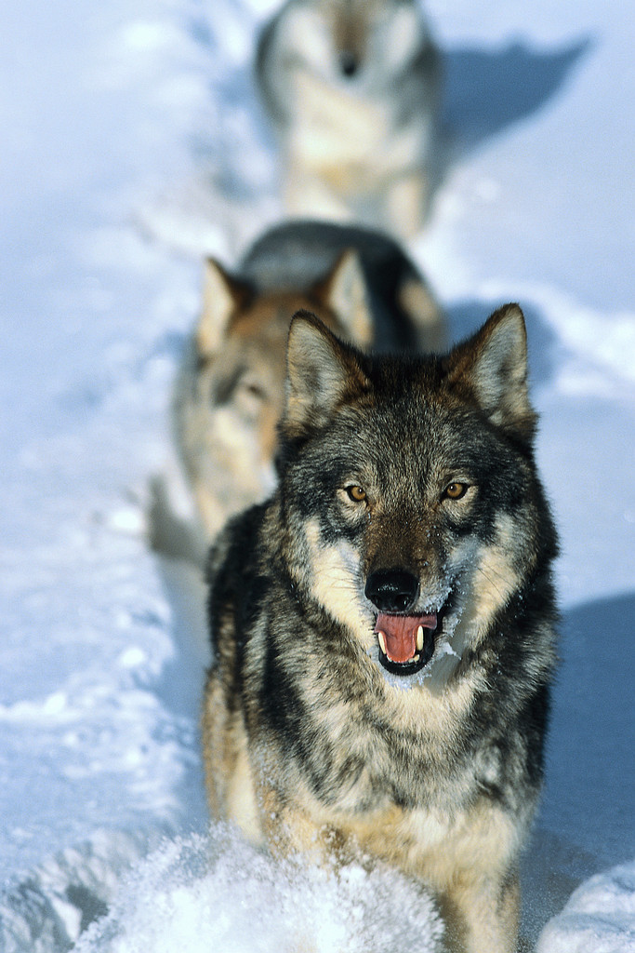
Simile
Definition
  Comparison between two or more items/ideas using like or as
Example
  The teenagers raided the fridge like a pack of hungry wolves.

Slide 3

Metaphor
Definition
  Comparison between two or more items/ideas not using like or as
Example
  When he gets tired, Colton is a bear!

Slide 4
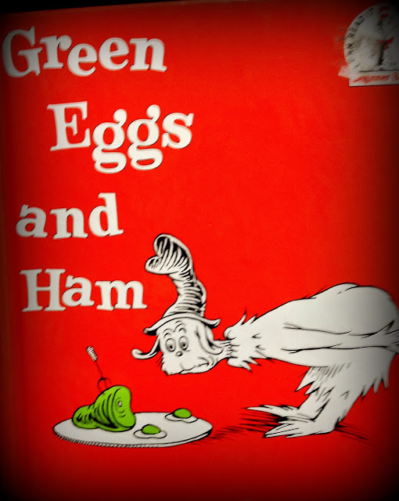
Rhyme
Definition
  Occurrence of similar or identical sounds at the end of two or more words
Example
  Suite, Heat, Complete
  Not, Hot
  The bear really does care.
  Do you like green eggs and ham?
  I do not like them Sam I am!
  - Dr. Suess’ Green Eggs and Ham

Slide 5

Repetition
Definition
  Technique in which a sound, word, phrase, or line is repeated for emphasis or unity
Example
  “Hit the road Jack. And don’t you come back no more, no more, no more, no more.”
    “Hit the Road Jack” by Ray Charles

Slide 6
Alliteration
Definition
  When words start with the same consonant sound
    The letters do not need to be the same – they just need to make the same sound
Example
  Kevin’s quick car crash caused quite a confusion in Kimball, Kentucky.
  Kimberly’s quick car insurance quote can save you cash.

Slide 7
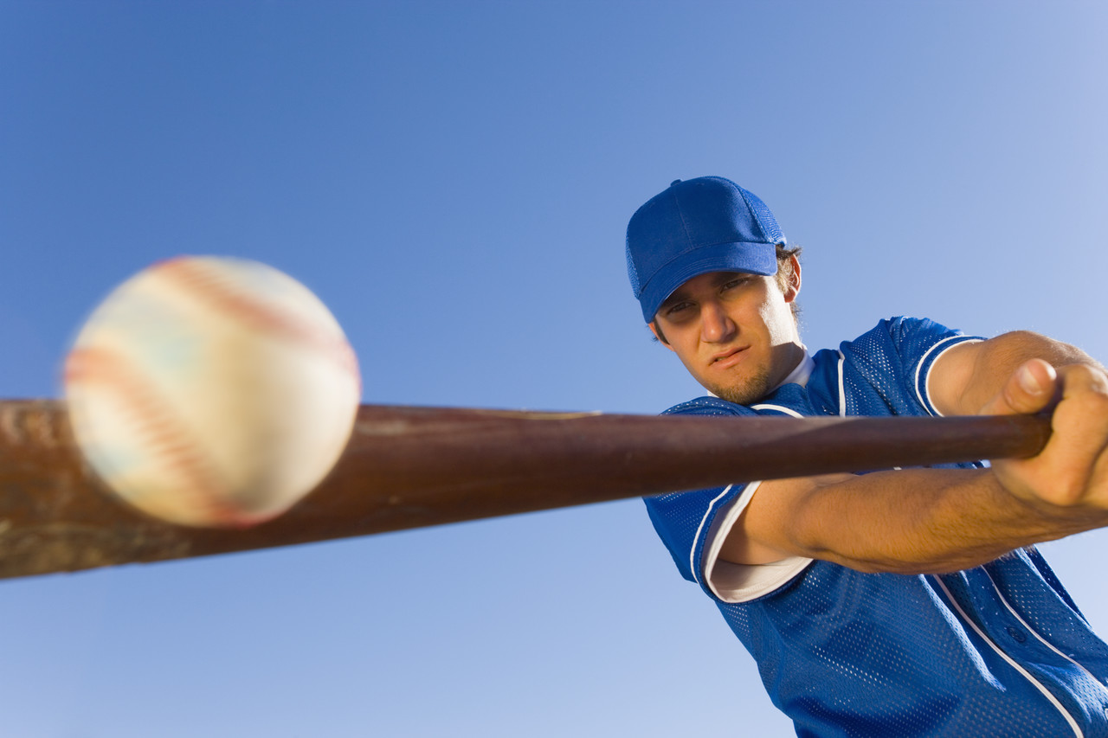
Assonance
Definition
  When the same vowel sound is repeated through a phrase of words that don’t rhyme
Example
  Jake the great hit the baseball in the air and out of the stadium.

Slide 8
Allusion
Definition
  A reference to something outside the work
Example
  They had a love like Romeo and Juliet.
  Sweets are my Achilles’ heel.

Slide 9
Hyperbole
Definition
  An extreme exaggeration
Example
  I had to wait for 100 years for my mom to finish cooking supper.

Slide 10
Personification
Definition
  Giving a non-human, human characteristics
Example
  The sun smiled as it shone on the newly married couple.

Slide 11

Symbolism
Definition
  A person, place, object, or activity that stands for something else
Example
  The white dove is a symbol for peace
  The bald eagle is a symbol for independence, freedom, and/or our nation

Slide 12

Imagery
Definition:
  Descriptive language that appeals to the senses
Example:
  As he walked the quiet lonely street, a sudden blur caught his attention. From that instant a shiver crawled up his spine as the wind howled around him. Suddenly he was aware of the slow, methodical footsteps that seemed to creep closer to him with every passing second.

Slide 13
Paradox/Oxymoron
Definition
  Paradox: Seemingly contradictory or absurd statement that may nonetheless suggest an important truth
  Oxymoron: Special kind of concise paradox that brings together two contradictory terms
Example
  “Honestly, I’m a compulsive liar.”
  Bittersweet
  Good Grief

Slide 14
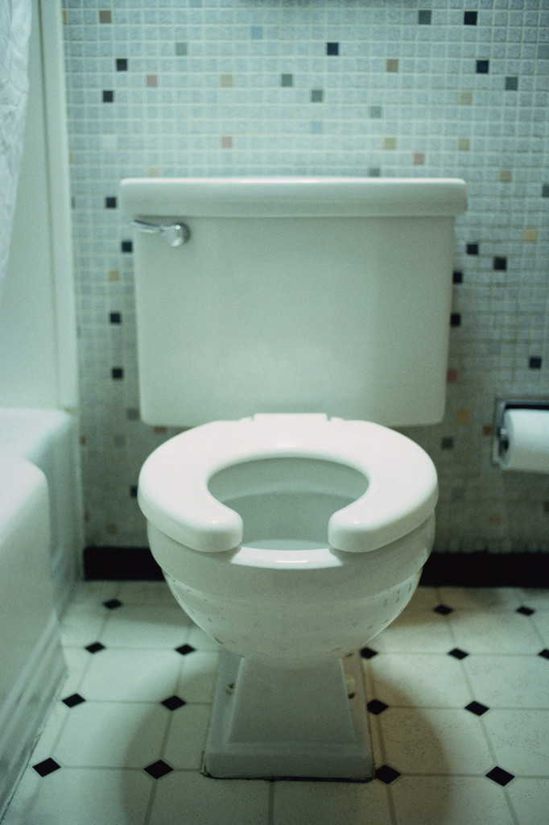
Euphemism
Definition
  A vague expression to express something
Example
  Toilet/Bathroom:
    Loo, Potty, John, Can, Throne, Little Girls/Boys Room

Slide 15
Idiom
Definition
  Colorful expression that means something different from the literal meaning
Example
  You drive me up the wall!
  Sick as a dog
  Chip on your shoulder
  Jumping the gun

Slide 16
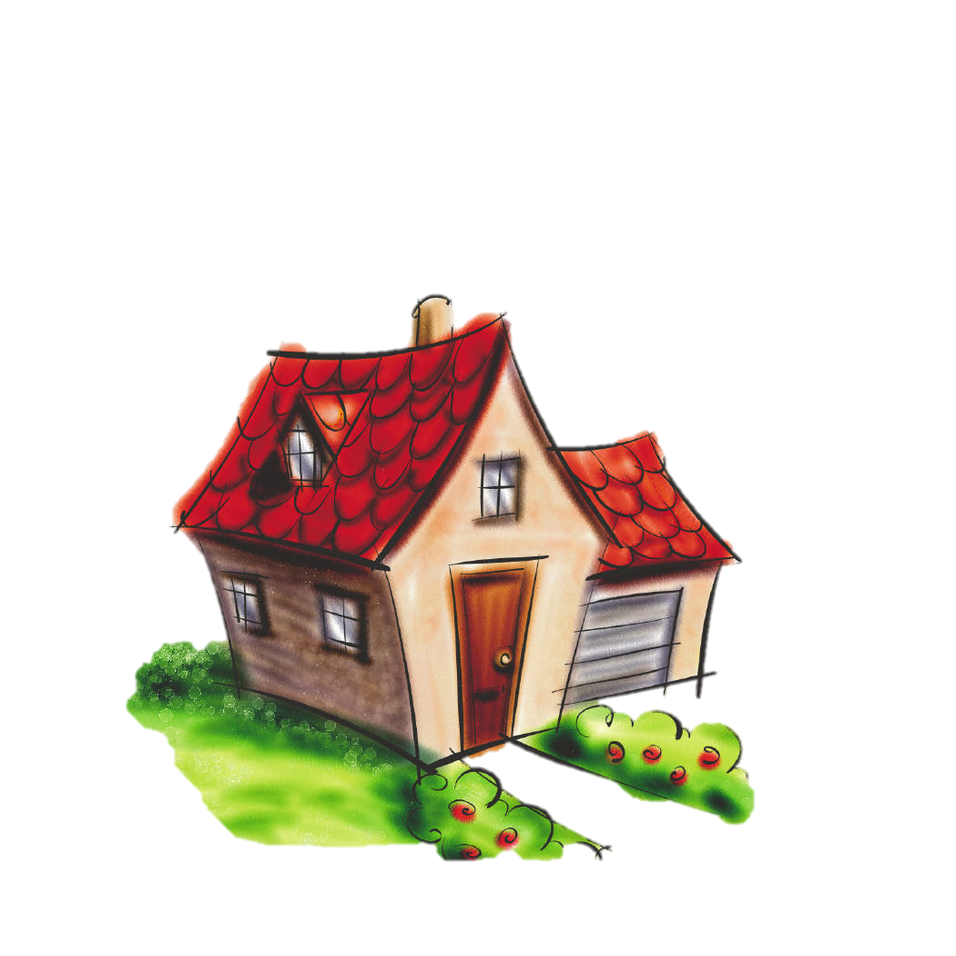
Connotation/Denotation
Definition
  Connotation: An attitude or feeling associated with a word
  Denotation: Literary meaning; dictionary definition
Example
  Connotation
    Home = Warmth, Comfort, Affection
  Denotation
    Home = house, apartment, or shelter

Slide 17

Nuance
Definition
  A very slight difference or variation in color or tone
Example
  Starting off bothered and switching to frustrated
  Starting off content and growing to happy

Slide 18
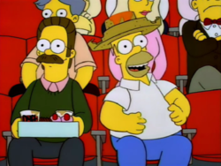
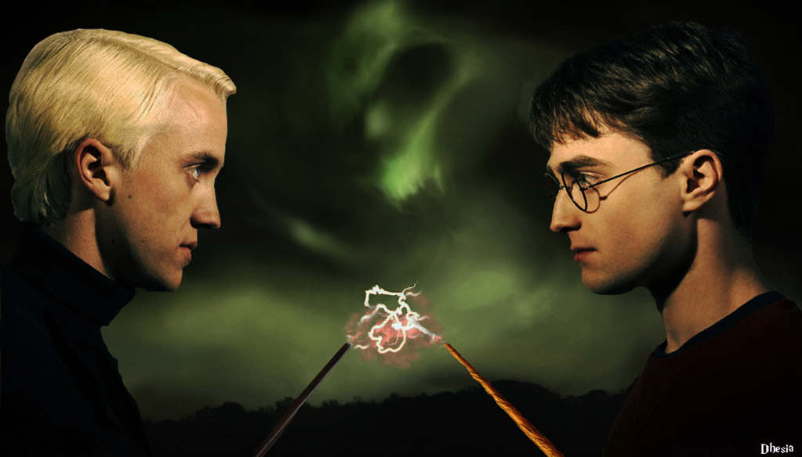
Foil
Definition
  A character who serves in contrast to another character
Example
  Homer Simpson and Ned Flanders
  Harry Potter and Draco Malfoy

Slide 19
Irony
Definition
  Where the intended meaning is different than what happens
    Verbal – Say one thing and mean another
    Situational – Situation is different than expected
    Dramatic – Reader knows something the character does not
Example
  Verbal: “No, I never knew that 2+2=4”
  Situational: Tom didn’t die in “Contents of a Dead Man’s Pockets”
  Dramatic: Juliet wasn’t really dead (we knew that) but Romeo did not

Slide 20

Characterization
Definition
  The development of characters to create images and an understanding of the character
    Direct
    Indirect
    STEAL: Speech, Thoughts/Feelings, Effects on Others, Actions, Looks
Example
  “He was a tall, lean, dark-haired young man in a pullover sweater, who looked as though he had played not football, probably, but basketball in college” (Finney).

