Slide 1
The Red Badge of Courage
By Stephen Crane

Slide 2
The Civil War
What do you know about the civil war?
Who was President during this time?
Why did it start?

Slide 3
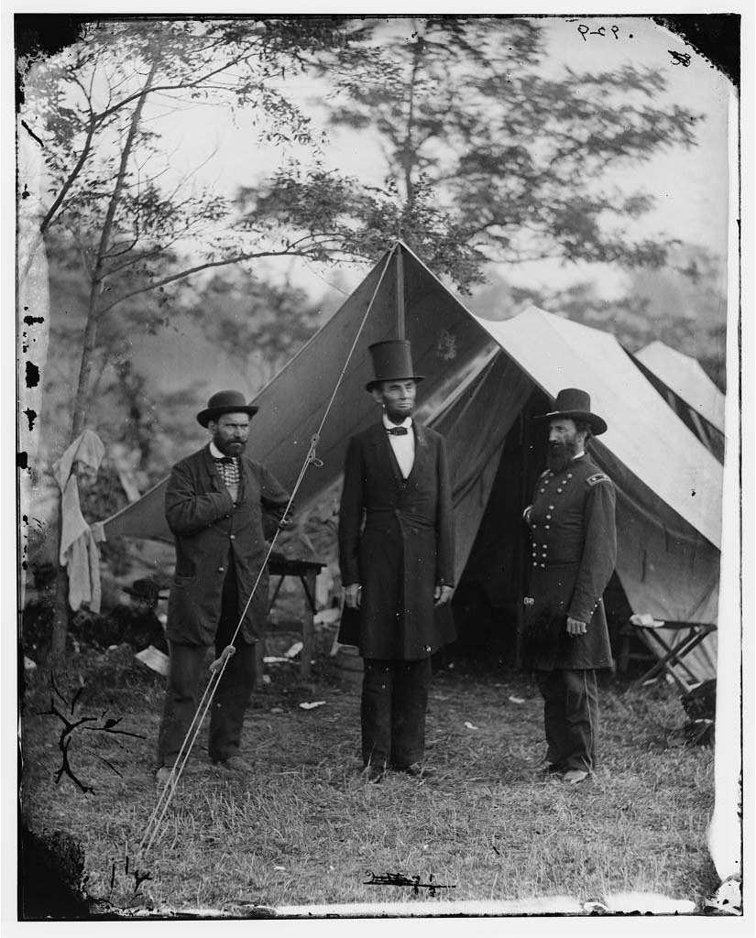

Slide 4
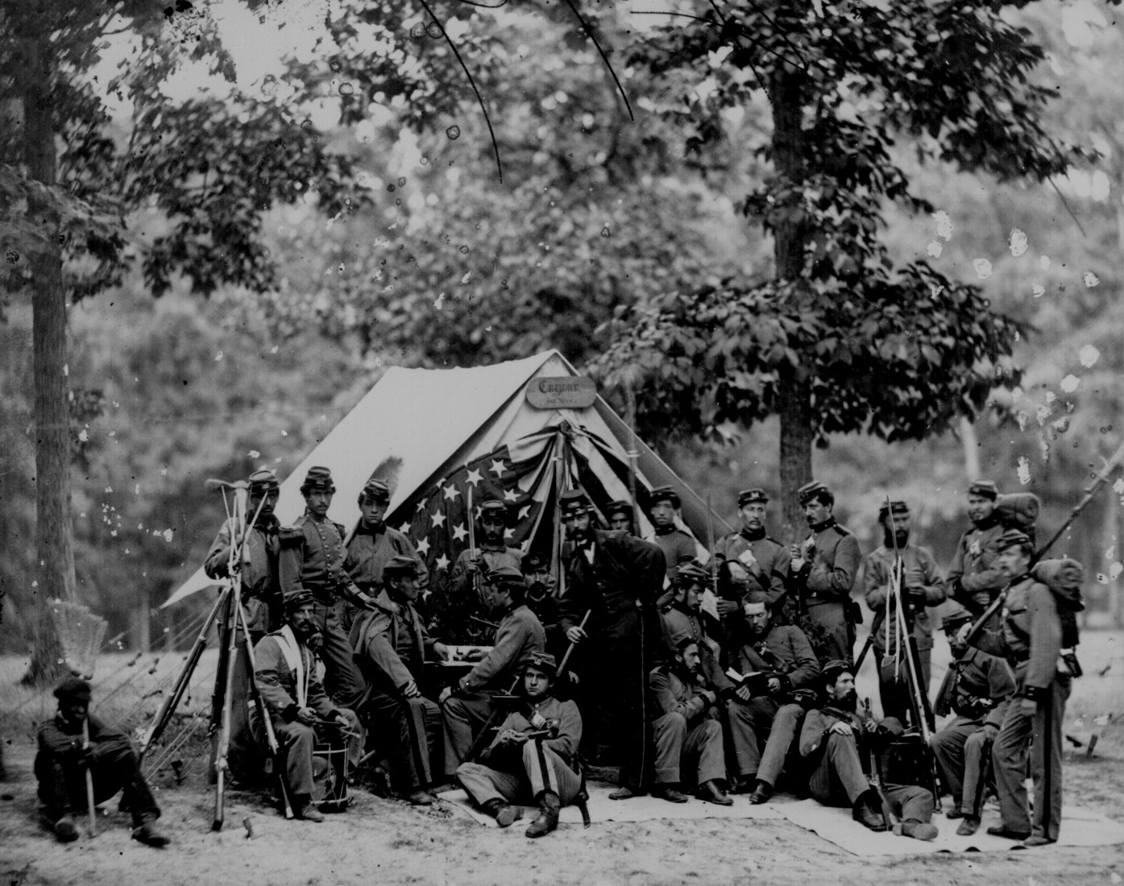

Slide 5
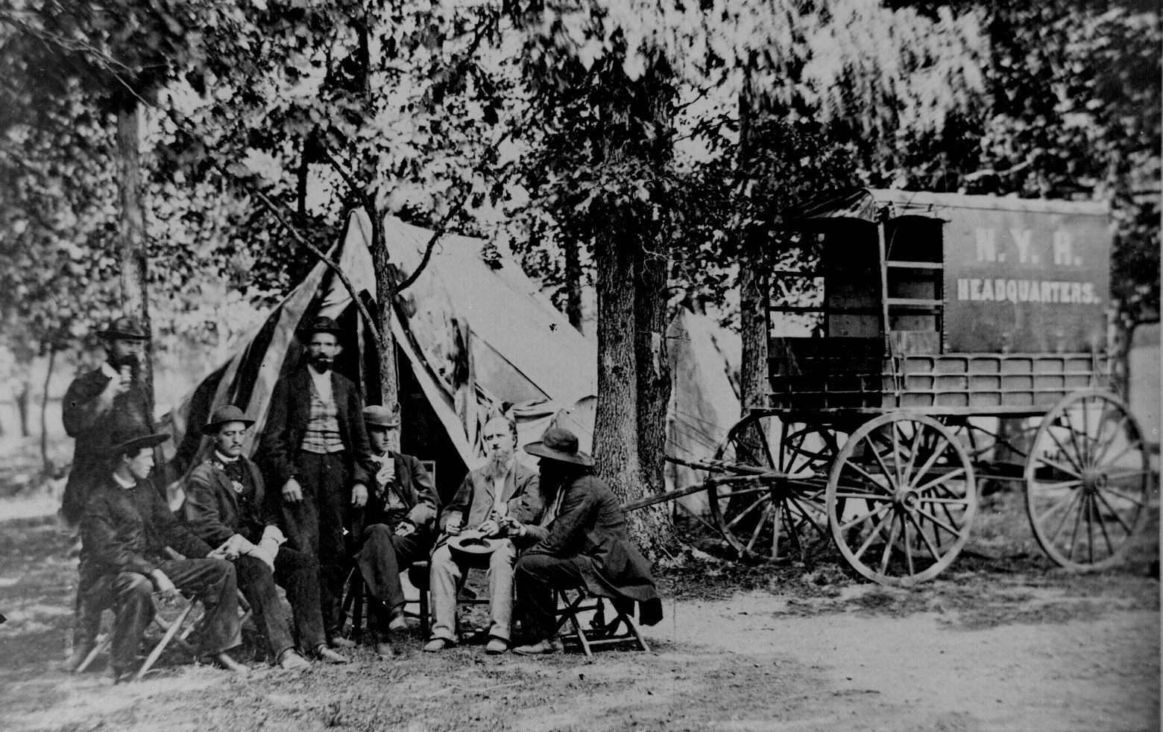

Slide 6
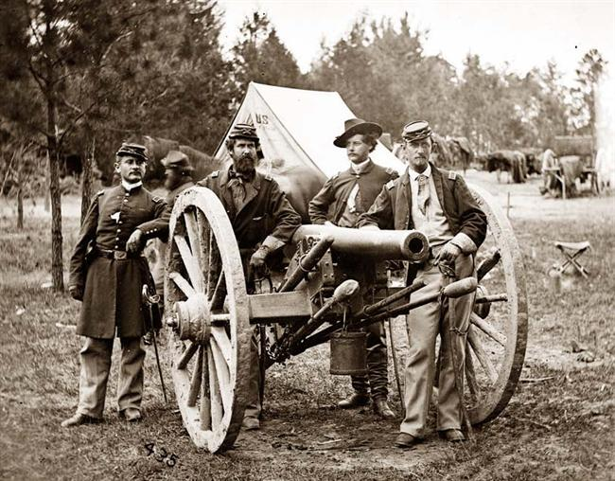

Slide 7
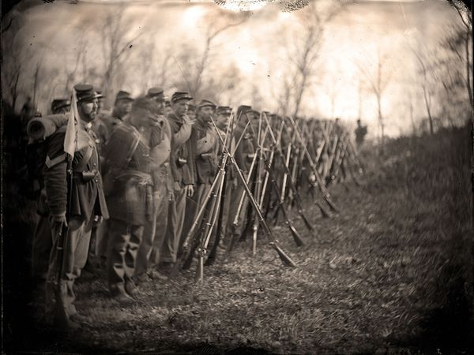

Slide 8
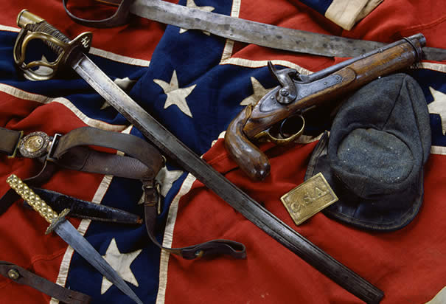

Slide 9
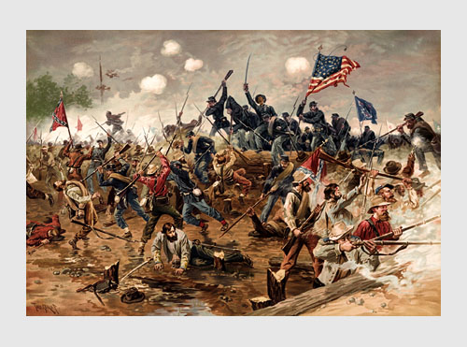

Slide 10
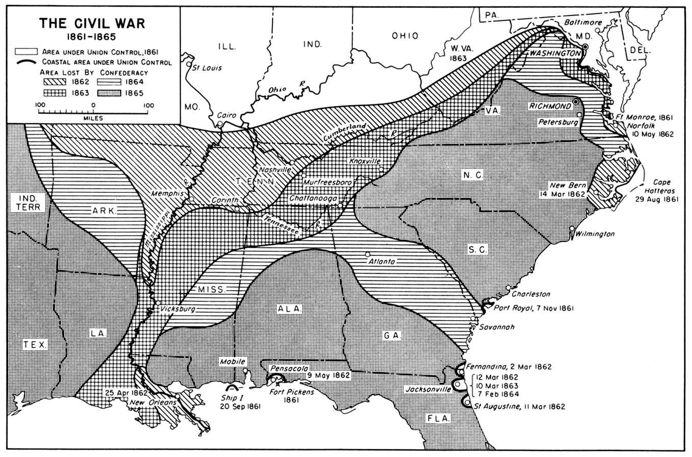

Slide 11
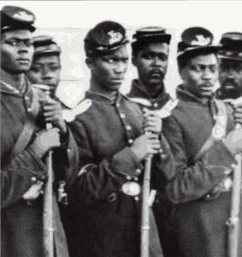

Slide 12
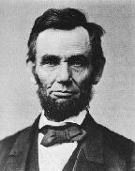

Slide 13
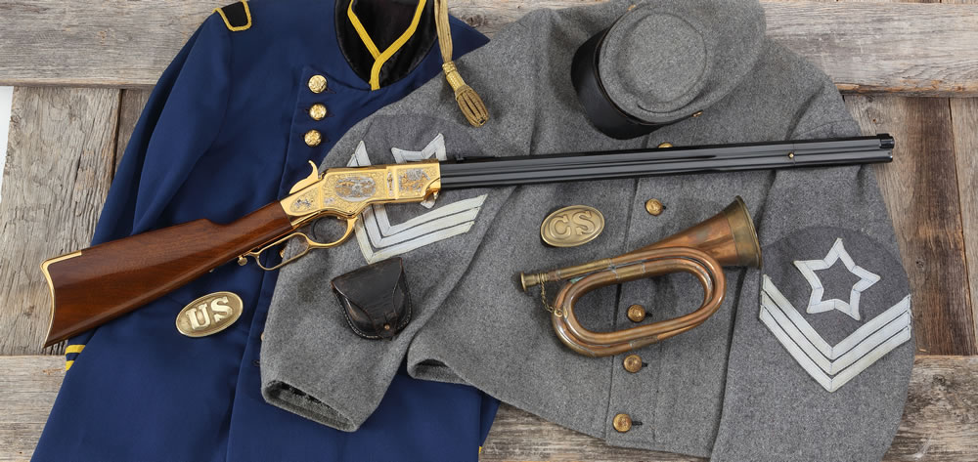

Slide 14
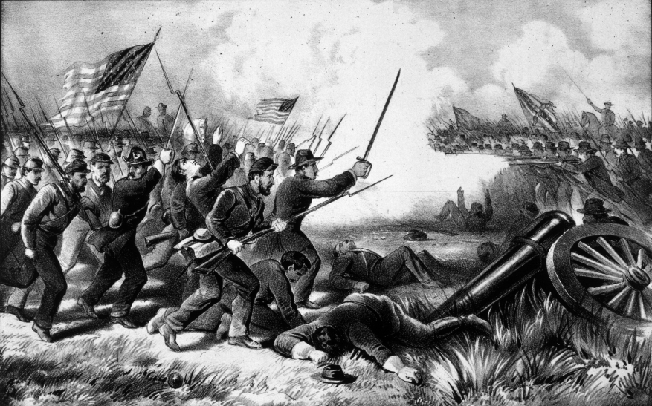

Slide 15
Discussion Questions
What kinds of situations challenge people to show courage?
What would you need to know about a situation before you judged someone else’s courage in facing it?
Desertion has always been considered shameful. During the Civil War it was punishable by death.
Suppose you were a soldier in a terrible battle. What would you do if most of the soldiers around you began to run away?
What would it take to maintain your courage?

